Slide 1
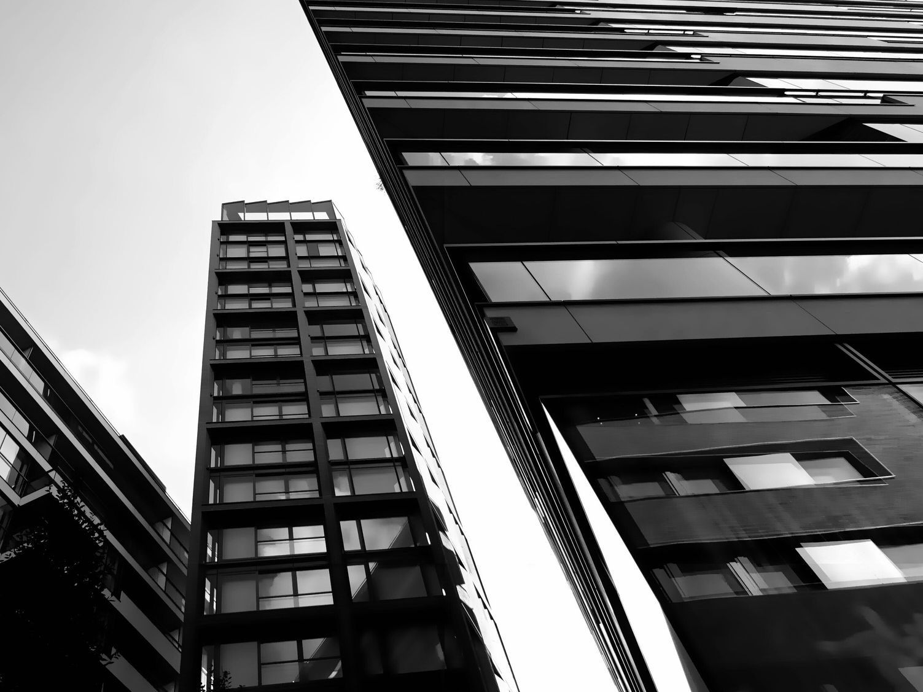
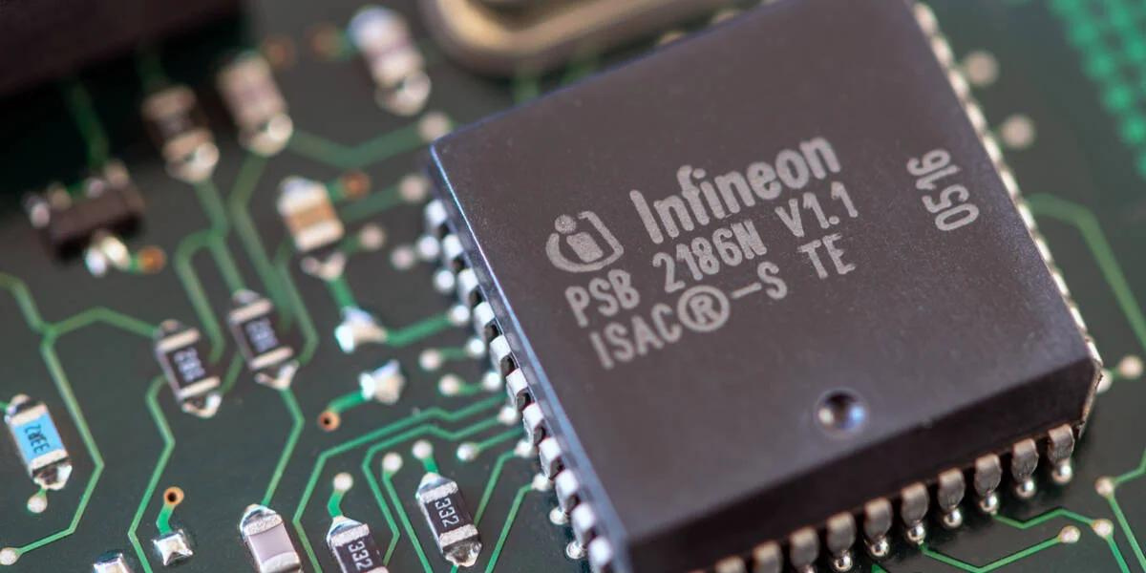


PRODUCT DEMAND FORECASTING
USING MACHINE LEARNING
Li Song Xi, Lin Bo-Hong,
Elizabeth Lim, Valeriia Korniushina
Technische Universität München | Infineon
TUM School of Management
Data Analytics in Application
14 July 2023

Slide 2
Presentation Overview
Topic Highlights
Business Understanding
Data Understanding
Data Preparation
Data Modeling
Evaluation
Deployment
Conclusion & Outlook

Slide 3
1. BUSINESS UNDERSTANDING

Slide 4
Business Understanding | Data Understanding | Data Preparation | Data Modeling | Evaluation | Deployment | Conclusion
Understanding the Environment – Chip Shortage
COVID-19 Pandemic
COVID-19 pandemic caused a disruption in supply chain and logistics 13% increase in global demand for computers
EARLY 2020
LATE 2020
2021
2022
Trade war between US and China
US Department of Commerce imposed restrictions on China’s largest chip manufacturer
Increase use of Cryptocurrency
Increase demand for cryptocurrency mining machines reduced the availability of chips for other users
Russian Ukraine War
Ukraine’s two leading suppliers of neon produce half of the world’s supply Neon is critical for lasers used to make chips
Source: https://supplychaindigital.com/top10/timeline-causes-of-the-global-semiconductor-shortage#

Slide 5
Business Understanding | Data Understanding | Data Preparation | Data Modeling | Evaluation | Deployment | Conclusion
Business Model Canvas
BUSINESS OBJECTIVES
PROJECT PLAN
Reduce manual forecasting efforts to predict demand
Improve short term forecasting accuracy to accurately forecast demand
Discover patterns that affects the demand of microchips
Develop strategies to deal with discontinued products
Data preparation & Data cleaning
Time Series Forecasting Methods
Autoregressive Integrated Moving Average (ARIMA)
Long Short-Term Memory (LSTM)
Random Forest
Aim to develop strategies that reduces the inaccuracy of over / under production of microchips produced
Aim to subsequently improve the overall production efficiency of the company
DEVELOPMENT GOALS

Slide 6
2. DATA UNDERSTANDING

Slide 7
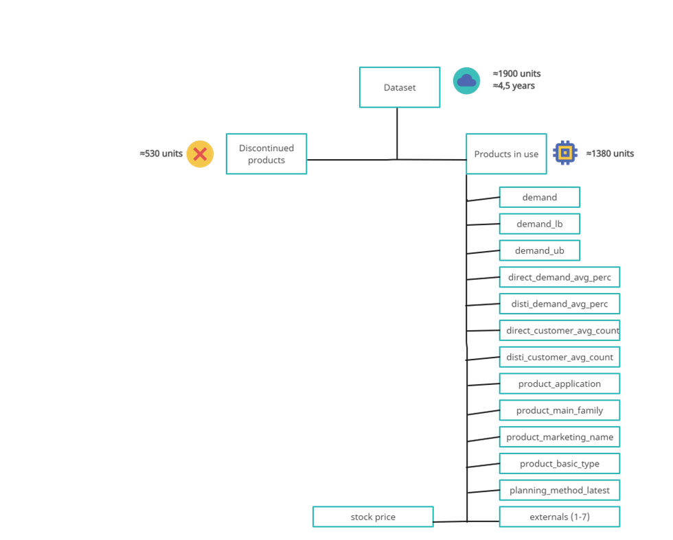
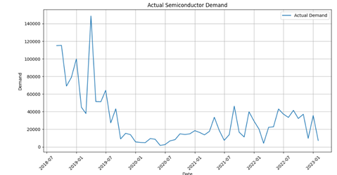
Business Understanding | Data Understanding | Data Preparation | Data Modeling | Evaluation | Deployment | Conclusion

Slide 8
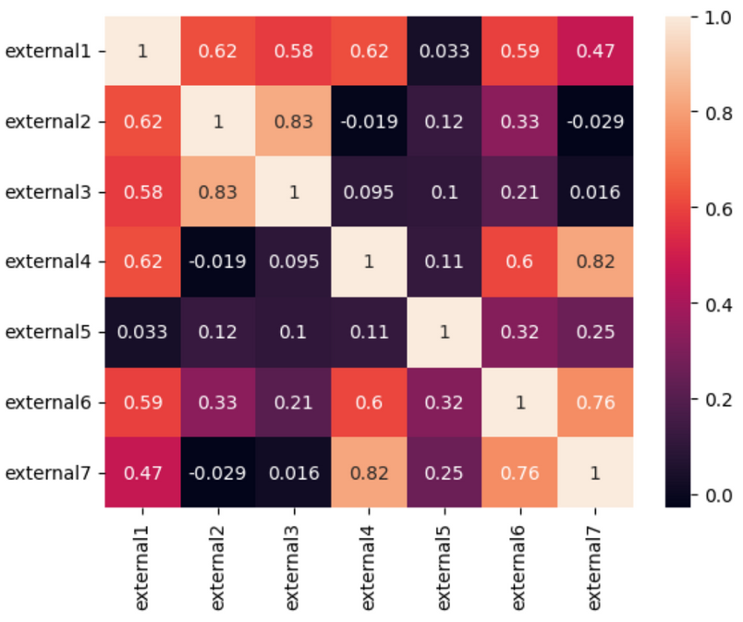
Business Understanding | Data Understanding | Data Preparation | Data Modeling | Evaluation | Deployment | Conclusion
High correlation
with external variables

Slide 9
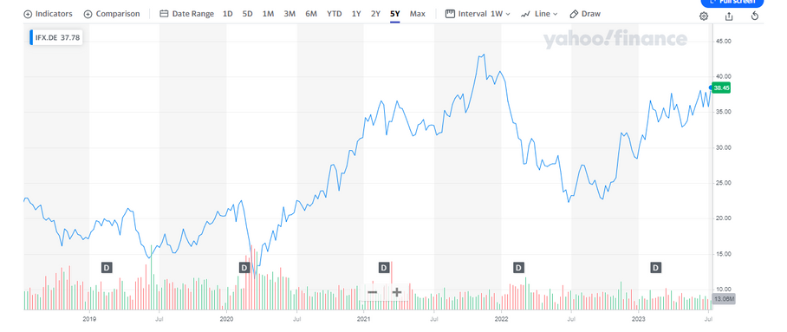
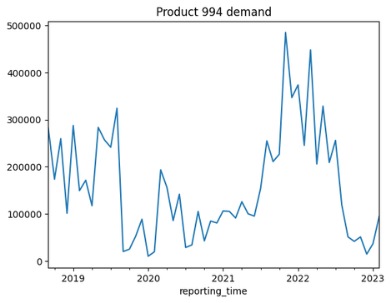
Business Understanding | Data Understanding | Data Preparation | Data Modeling | Evaluation | Deployment | Conclusion
Behaviour of considered variable
Source:YahooFinance.Infineon Technologies AG (IFX.DE)

Slide 10
3. DATA PREPARATION

Slide 11
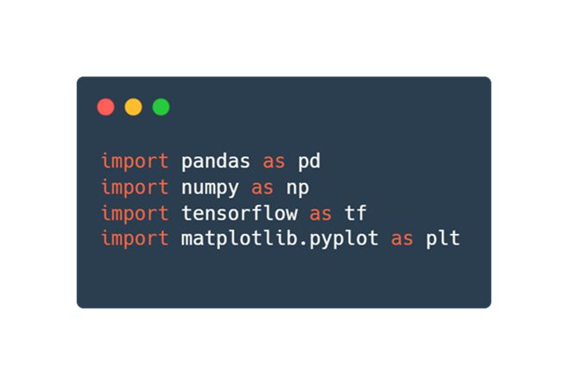
Business Understanding | Data Understanding | Data Preparation | Data Modeling | Evaluation | Deployment | Conclusion
Step 1: Importing Library & Dataset
IMPORTING NECESSARY LIBRARY
IMPORTING DATASET INTO PYTHON

Slide 12
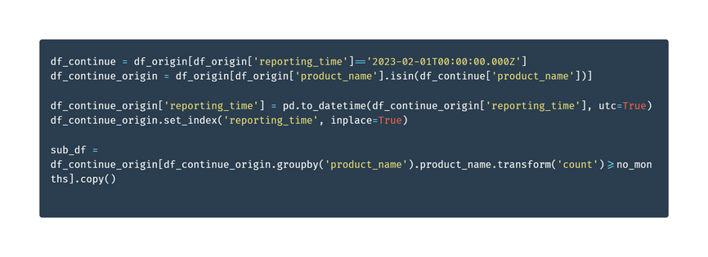
Business Understanding | Data Understanding | Data Preparation | Data Modeling | Evaluation | Deployment | Conclusion
Step 2: Remove discontinued products
DISCONTINUED PRODUCTS
Products which are no longer active in the dataset
Remote Discontinued products so machine learning model would not be affected by these products
REMOVING DISCONTINUED PRODUCTS

Slide 13
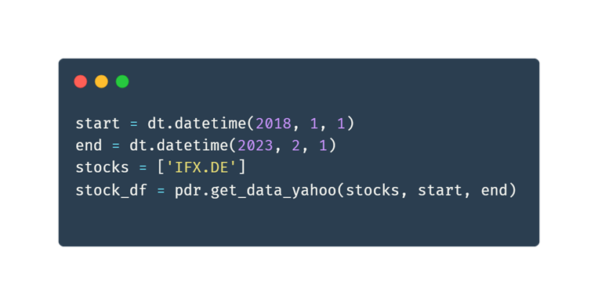
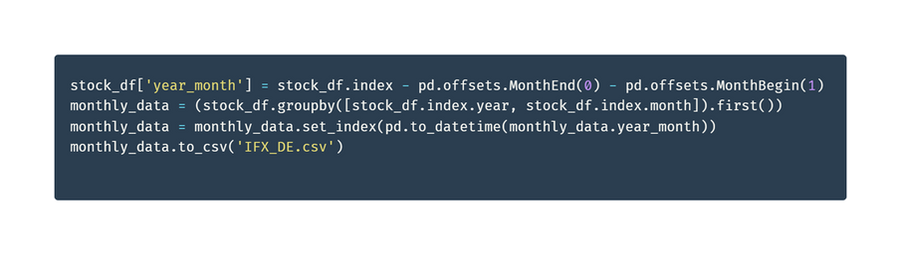
Business Understanding | Data Understanding | Data Preparation | Data Modeling | Evaluation | Deployment | Conclusion
Step 3: Importing YahooFinance Data
INFINEON STOCK PRICE @YAHOOFINANCE
Check correlation between Semiconductor microchip demand vs Infineon Stock Price
RETRIEVING INFINEON DATA FROM YAHOOFINANCE
SET MONTHLY DATA POINT TO BE THE START OF EACH MONTH DATA

Slide 14
4. DATA MODELING

Slide 15



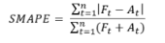
Business Understanding | Data Understanding | Data Preparation | Data Modeling | Evaluation | Deployment | Conclusion
Overall modelling strategy.
Libraries used for modeling:
Darts
Keras
RandomForest
Models used: ARIMA, LSTM and RandomForest
ARIMA will be fit and tuned as the benchmark
LSTM and Random Forests will then be compared to ARIMA
Choose best models to be used for cold start prediction
Metric used: SMAPE

Slide 16
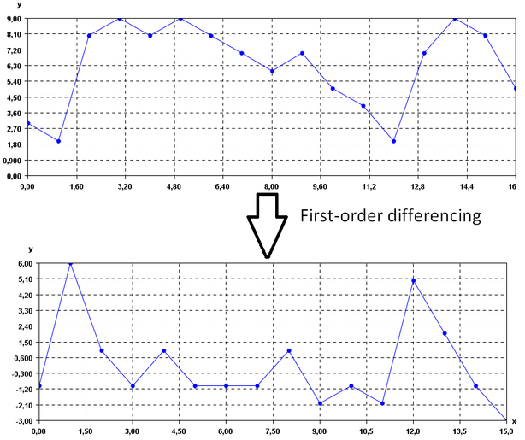

Business Understanding | Data Understanding | Data Preparation | Data Modeling | Evaluation | Deployment | Conclusion
ARIMA overview
What is (AR)(I)(MA)?
AR (Auto Regressive):
I (Integrative):
MA (Moving Average):
Considers the effectiveness of lags in predicting a future data point.
Assumes future values are dependent on past values.
The order of differencing to ensure the data is Stationary.
Differencing involves subtracting the current period from the future value.
Can remove seasonality from the series
Considers the dependency of a future datapoint with the residual error of a lag
First order differencing
Source:Calculate The First Order Differencing Of Time Series

Slide 17
Business Understanding | Data Understanding | Data Preparation | Data Modeling | Evaluation | Deployment | Conclusion
MODELING ARIMA
DEFAULT MODEL:
FORECASTING FOR COVARIATES:
AutoARIMA from Darts
A wrapper of pmdarima’s implementation
Automatically chooses best order of differencing based on statistical test (Kwiatkowski–Phillips–Schmidt–Shin), and order of lags and moving average based on an information criterion (hqic).
Accounts for seasonality and selects best order of model for seasonal periods
Train Data: Using 0.7 of all data as train data
Error Indicator: SMAPE
Predict: test set + 18 months is forecasted
Forecasted covariates individually using ARIMA vs Exponential Smoothing
Overall the SMAPE for ARIMA was better and thus ARIMA was chosen to forecast covariates.
Forecasted covariates are used as future covariates
HANDLING MULTICOLLINEARITY
USING VIF:
Variance Inflation Factor (VIF) is used to test the correlation between variables.
We use a threshold of 5 to indicate if an external variable
Repeatedly remove covariate with VIF higher than threshold until all covariates have VIF < threshold

Slide 18
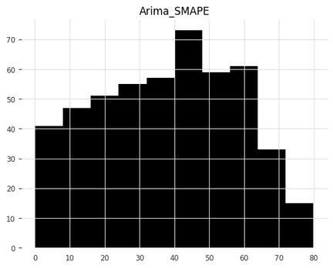
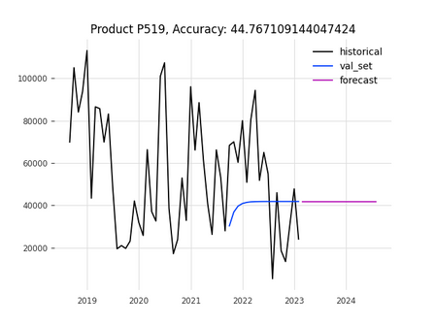
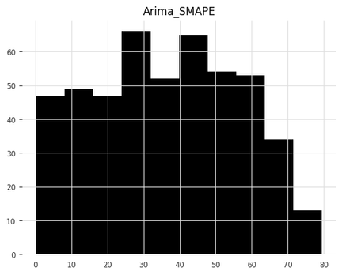
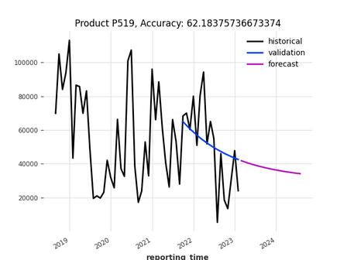
Business Understanding | Data Understanding | Data Preparation | Data Modeling | Evaluation | Deployment | Conclusion
ARIMA results
Without Covariates
1031 forecasts
With Covariates
480 forecasts

Slide 19
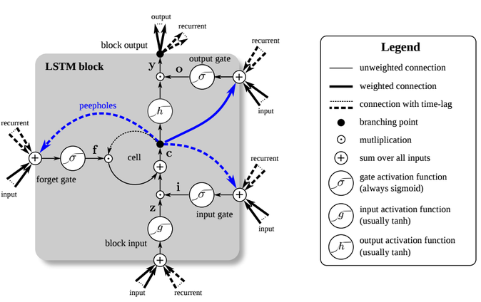
Business Understanding | Data Understanding | Data Preparation | Data Modeling | Evaluation | Deployment | Conclusion
Long Short-Term Memory - concept
What is LSTM?
a type of recurrent neural network (RNN) architecture that is specifically designed to capture long-term dependencies in sequential data.
widely used in various time series forecasting tasks, including product demand prediction.
Source:Long Short-Term Memory (LSTM) | NVIDIA Developer
Key Features of LSTM:
Memory Cells: allow networks remember information over long sequences.
Forget, Input, and Output Gates: control information flow and selectively retain or discard data from previous time steps.
Backpropagation Through Time: compute gradients, updating its parameters to minimize the loss and capture dependencies across time steps in the sequential data.

Slide 20
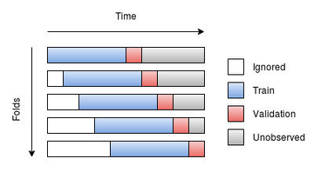
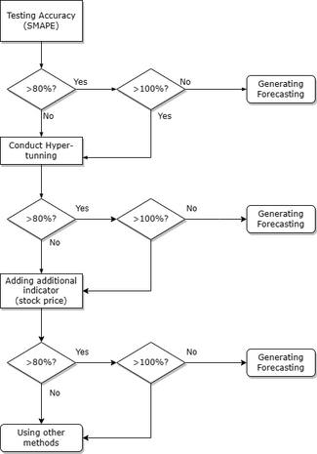
Business Understanding | Data Understanding | Data Preparation | Data Modeling | Evaluation | Deployment | Conclusion
LSTM - Model and hyperparameter tuning
DEFAULT MODEL:
Train Data: using features of previous 15 months to predict feature of next month
Features: choosing best 8 features from correlation between features and demand
Error indicator: SMAPE
Implement Sequential model from keras package and add 2 LSTM layers of 50 memory units with 0.2 dropout rate and 1 Dense layer, setting output as 8 features
Prediction: After generating an output, put it to the bottom of historical data and use it as input
HYPERPARAMETER TUNING
Train Data: same as default model
Features: same as default model
Error indicator: SMAPE
Testing the combination of memory units, batch_size, dropout rate and find the best set for the model

Slide 21
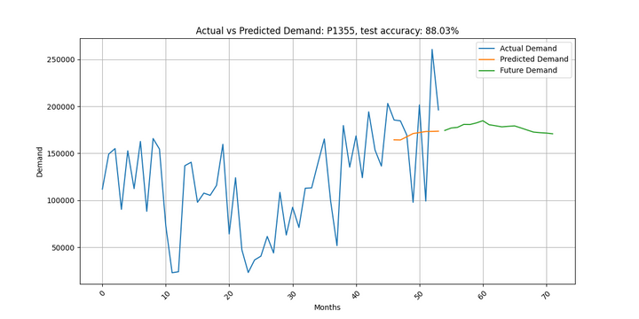
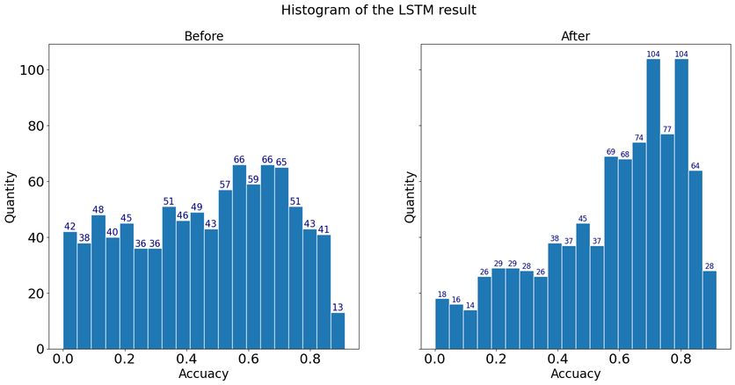
Business Understanding | Data Understanding | Data Preparation | Data Modeling | Evaluation | Deployment | Conclusion
LSTM - Results

Slide 22

Business Understanding | Data Understanding | Data Preparation | Data Modeling | Evaluation | Deployment | Conclusion
Random Forest - concept and model
WHAT IS RF?
Versatile machine learning algorithm used for both classification and regression tasks.
combines multiple decision trees to make predictions.
Each decision tree in the random forest is trained on a random subset of the training data and features.
DEFAULT MODEL:
Train Data: using features of previous 15 months to predict feature of next month
Features: choosing best 8 features from correlation between features and demand
Error indicator: SMAPE
Implement RandomForestRegressor from sklearn.ensemble
Sou﻿rce: RandomForestRegressor from sklearn.ensemble

Slide 23
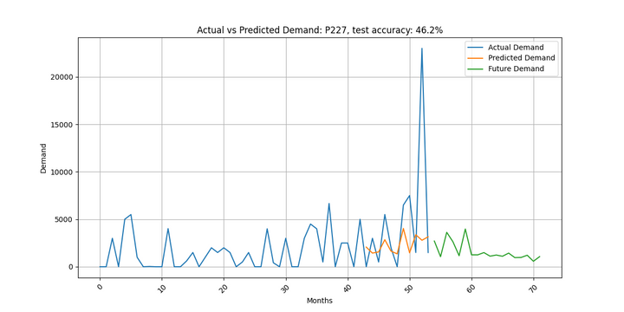
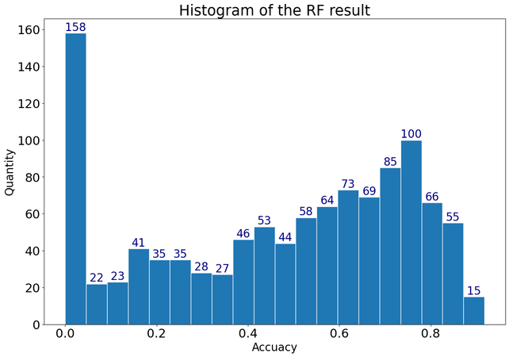
Business Understanding | Data Understanding | Data Preparation | Data Modeling | Evaluation | Deployment | Conclusion
RF - Results

Slide 24
5. EVALUATION

Slide 25
Business Understanding | Data Understanding | Data Preparation | Data Modeling | Evaluation | Deployment | Conclusion
Comparison of models
Threshold (Accuracy) | Arima | LSTM | Random Forest
>50% | 151 | 629 | 589
>60% | 71 | 514 | 456
other (smape less than 0 or larger than 1) | 539 | 321 | 290
Average | 37% | 57% | 46%

Slide 26
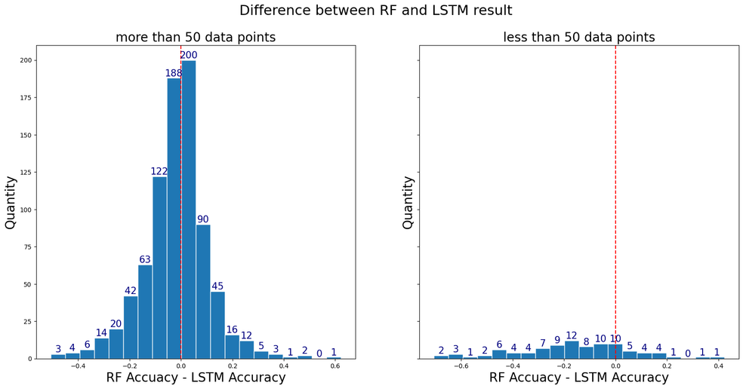
Business Understanding | Data Understanding | Data Preparation | Data Modeling | Evaluation | Deployment | Conclusion
Comparison of models
Compare accuracy of same product to see which one performs better

Slide 27
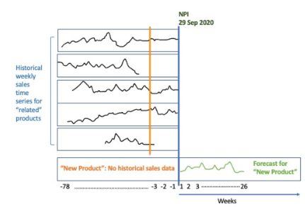
Business Understanding | Data Understanding | Data Preparation | Data Modeling | Evaluation | Deployment | Conclusion
Cold Start
The problem:
A typical problem in manufacturing.
We would like to predict the demand of products that do not exist yet and have no historical data.
Thus, we rely on categorical variables for information about new product
Categorical variables we have:
product_application
product_main_family
product_marketing_name
product_basic_type
Source:Build a cold start time series forecasting engine using AutoGluon

Slide 28
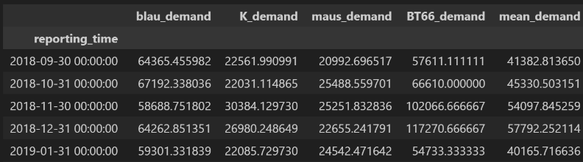
Business Understanding | Data Understanding | Data Preparation | Data Modeling | Evaluation | Deployment | Conclusion
Cold Start
method 1
Strategy:
Group all categorical columns by their respective categories and create respective time series
Get new products in terms of their categorical variables. e.g. {'product_application': 'blau', 'product_main_family':'K', 'product_marketing_name':'maus', 'product_basic_type': 'BT66'}
Get mean across all columns. Ignore nan values
Forecast using LSTM
Assumed that the demand of a categorical variable have the same mean

Slide 29
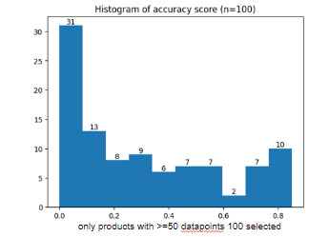
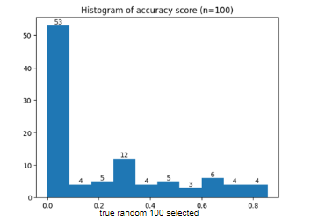
Business Understanding | Data Understanding | Data Preparation | Data Modeling | Evaluation | Deployment | Conclusion
Cold Start
results
Validation:
Choose existing product categorical variable combination. e.g.
{'product_application': 'blau', 'product_main_family':'K', 'product_marketing_name':'maus', 'product_basic_type': 'BT66'}
predict using LSTM after forming mean of all TS of categorical products
compare to actual to forecast

Slide 30
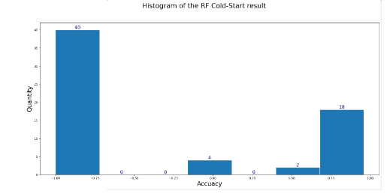
Business Understanding | Data Understanding | Data Preparation | Data Modeling | Evaluation | Deployment | Conclusion
Cold Start
method 2
Filtering same product baic type(eg. BT223) of data, encode the string value inside to integer and use them with all features as training data to random forest regressor

Slide 31
6. DEPLOYMENT

Slide 32
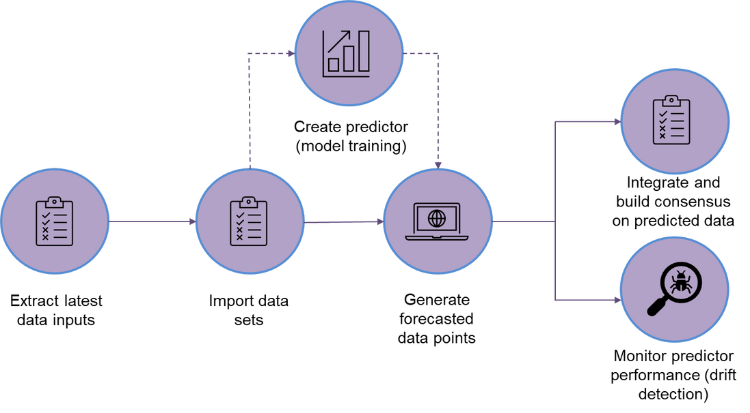
Business Understanding | Data Understanding | Data Preparation | Data Modeling | Evaluation | Deployment | Conclusion
Deployment and Workflow

Slide 33
7. CONCLUSION & OUTLOOK

Slide 34
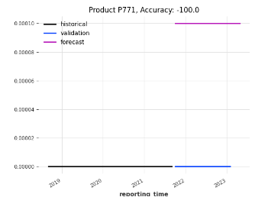
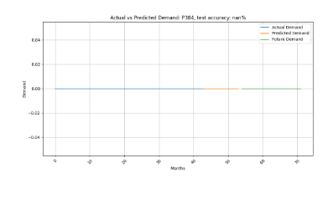
Business Understanding | Data Understanding | Data Preparation | Data Modeling | Evaluation | Deployment | Conclusion
Challenges Faced/Limitations
SMAPE does not handle 0 well. Depending on the library used, may return unusual figures or nan values after calculation

Slide 35
Business Understanding | Data Understanding | Data Preparation | Data Modeling | Evaluation | Deployment | Conclusion
Conclusion & Outlook
Out of all models we tried, LSTM performed the best, however, we have not tried to use hyperparameter tuning in Random forest regressor.
Based on Arima method, while including covariates improved some model’s forecasting accuracy, it also worsened many others. As a result, number of models that were above 0% accuracy score were produced. Future steps could include selecting whether to use covariates based on the performance. Another method we could try would be to use a recursive strategy instead.
We discovered another method of cold start forecasting through Amazon’s method(with package Autogluon) and we would like to have tried it in the future

Slide 36
THANK YOU!
Questions?

Slide 37
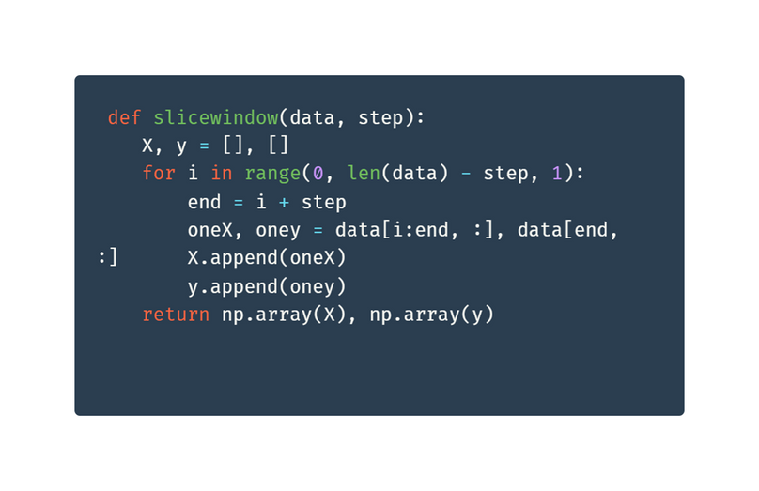
Business Understanding | Data Understanding | Data Preparation | Data Modeling | Evaluation | Deployment | Conclusion
Step 3: Creating Slice Window (For LSTM Model)
SLICE WINDOW
Dividing sequence of data into smaller segments or windows
Allows analysis of each window separately, to focus on patterns or information within that specific segment
For every 15 months, we predict 1 month

Slide 38
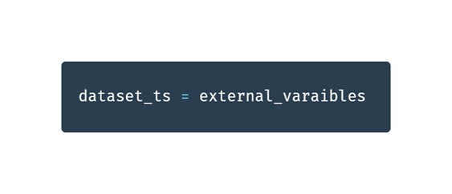
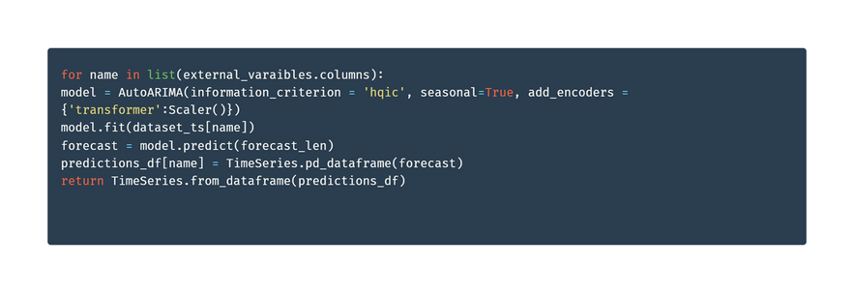
Business Understanding | Data Understanding | Data Preparation | Data Modeling | Evaluation | Deployment | Conclusion
Step 3: Creating AutoARIMA (For ARIMA Model)
Forecasts future values for each column in a dataframe
Stores the prediction in a separate dataframe
CONVERT DATASET INTO TIME SERIES
CREATE LOOP FOR AUTOARIMA

Slide 39
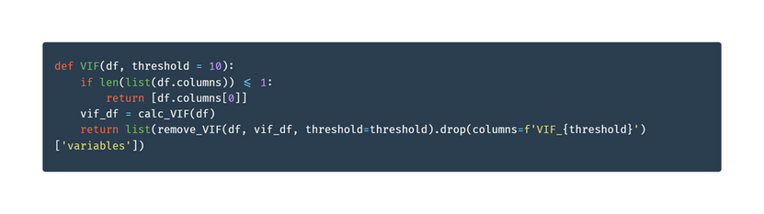
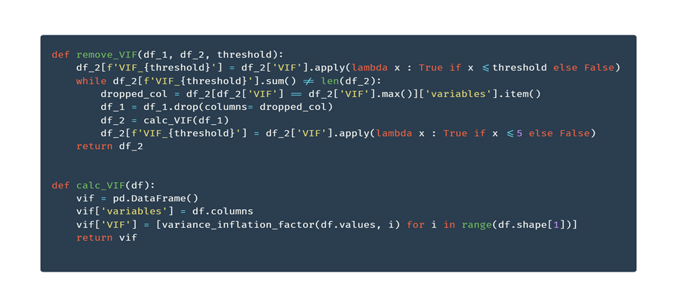
Business Understanding | Data Understanding | Data Preparation | Data Modeling | Evaluation | Deployment | Conclusion
Step 4: Highly correlated value (For ARIMA Model)
Determine correlation using Variance Inflation Factors (VIF)
DETERMINE HIGHLY CORRELATION BETWEEN PREDICTOR VARIABLES
REMOVE HIGHLY CORRELATED VARIABLES WITH HIGH VIF

Slide 40
Gültigkeit der Masterfolien
Dieser Folienmaster gilt bei offiziellen Präsentationen im Rahmen der TUM.
Es ist darauf zu achten, dass wir uns in einem durchgängigen Layout präsentieren.
Abweichungen vom vorgegebenen Layout bitte auf ein Minimum reduzieren.
Dr. rer. nat. Erika Mustermann (TUM) | kann beliebig erweitert werden | Infos mit Strich trennen
‹#›

Slide 41
Grundlage der Masterfolien
Als Grundlage dient der Corporate Design Style Guide der TUM.
Die Präsentationsvorlage ist auf gute Lesbarkeit und klare Darstellung von Informationen optimiert.
Dr. rer. nat. Erika Mustermann (TUM) | kann beliebig erweitert werden | Infos mit Strich trennen
‹#›

Slide 42
Hier steht eine Überschrift
max. 2-zeilig
Als Grundlage dient der Corporate Design Style Guide der TUM.
Die Präsentationsvorlage ist auf gute Lesbarkeit und klare Darstellung von Informationen optimiert.
Dr. rer. nat. Erika Mustermann (TUM) | kann beliebig erweitert werden | Infos mit Strich trennen
‹#›

Slide 43
Schrift
Das Grundprinzip ist, Informationen bestmöglich zu transportieren. Dazu muss vor allem die Schrift einheitlich und für alle im Raum lesbar sein.
Schriftart: Arial
Schriftgrößen:30 | 22 | 16 | 12
Zeilenabstand: 1,15mm
Die Einstellungen sind in den Textfeldern und Textfeldvorlagen dieses ppt-Masters als Standard eingestellt. Bei Diagrammen und Tabellen muss die Schriftgröße ggf. angepasst werden. Für Auszeichnungen im Fließtext kann auch fett markiert werden.
Bei großer Distanz bzw. kleinem Präsentationsmedium kann der Schriftgrad notfalls proportional erhöht werden.
Dr. rer. nat. Erika Mustermann (TUM) | kann beliebig erweitert werden | Infos mit Strich trennen
‹#›

Slide 44
Farben
Als erstes soll mit schwarz und weiß gearbeitet werden.
Für Aufwändigere Darstellungen sind Farben mit Bedacht und in möglichst geringem Umfang einzusetzen.
In diesem Folienmaster ist die Farbpalette festgelegt.
Zuerst mit den Primärfarben arbeiten.
Für z.B. komplexe Diagramme stehen nochSekundärfarben zur Verfügung.
Gering im Einsatz sind die Akzentfarben.
Dr. rer. nat. Erika Mustermann (TUM) | kann beliebig erweitert werden | Infos mit Strich trennen
‹#›

Slide 45
Texte
Kurze und knappe Texte, Fließtexte linksbündig, kein Blocksatz
Beispiel:
Tem soluptam, nisi as verum ereprehendam at acculpa quidisq uissit volupta tusdant utem as etur, odi odis es doluptiae dem nimaion con nossinctenis pora quam voloria consenimus blabore everfer epeliquo maio etur.
Dr. rer. nat. Erika Mustermann (TUM) | kann beliebig erweitert werden | Infos mit Strich trennen
‹#›

Slide 46
Aufzählung
Bei kleinen Aufzählungen auf Aufzählungszeichen verzichten und ggf. zusätzliche Leerzeile
Nur die wesentlichen Punkte nennen und Themen auf verschiedene Seiten splitten.
Punkt 1
Punkt 2
Wenn Unterpunkte in einer Aufzählung nötig sind ist ein Einrücken mit – möglich
Unterpunkt 1
Unterpunkt 1
Unterpunkt 2
Bei größeren Listen die Standardeinstellung • verwenden
Unterpunkt 1
Unterpunkt 2
Unterpunkt 3
Dr. rer. nat. Erika Mustermann (TUM) | kann beliebig erweitert werden | Infos mit Strich trennen
‹#›

Slide 47
Bilder - Allgemein
schlichte Darstellung von Informationen
reduzierte Farben
Rahmen und Überlagerungen nach Möglichkeit vermeiden
Dr. rer. nat. Erika Mustermann (TUM) | kann beliebig erweitert werden | Infos mit Strich trennen
‹#›

Slide 48
Bilder
Bildbeschreibung
oberer Bildrand: Begrenzung durch Text
Dr. rer. nat. Erika Mustermann (TUM) | kann beliebig erweitert werden | Infos mit Strich trennen
‹#›

Slide 49
Bilder
Überschrift 2
Hier steht ein einleitender oder beschreibender Fließtext und nach Wunsch eine Aufzählung
Punkt 1
Punkt 2
Punkt 3
Punkt 4
Dr. rer. nat. Erika Mustermann (TUM) | kann beliebig erweitert werden | Infos mit Strich trennen
‹#›

Slide 50
Bilder
Bildbeschreibung
oberer Bildrand: Begrenzung durch Text
Dr. rer. nat. Erika Mustermann (TUM) | kann beliebig erweitert werden | Infos mit Strich trennen
‹#›

Slide 51
Bilder
Bildbeschreibung
oberer Bildrand: Begrenzung durch Text
Dr. rer. nat. Erika Mustermann (TUM) | kann beliebig erweitert werden | Infos mit Strich trennen
‹#›

Slide 52
Nicht formatfüllende Bilder
Weißer bzw. transparenter Hintergrund
mit genug Freiraum anordnen
Dr. rer. nat. Erika Mustermann (TUM) | kann beliebig erweitert werden | Infos mit Strich trennen
‹#›

Slide 53
Bilder Format füllend - maximale Bildgröße
Dr. rer. nat. Erika Mustermann (TUM) | kann beliebig erweitert werden | Infos mit Strich trennen
‹#›

Slide 54
Nicht Format füllende Bilder
Alternativ mit formatfüllendem Hintergrund: 5 % schwarz
Beschriftungen können zusätzlich neben den Bildern angebracht werden
Bilderklärung
Dr. rer. nat. Erika Mustermann (TUM) | kann beliebig erweitert werden | Infos mit Strich trennen
‹#›

Slide 55
Tabelle – Beispiel 1
Tabelle ohne Farbe und kein Rand
innerer Seitenrand links 0 cm, oben z.B. 0,5 cm (für genug Zeilenabstand innerhalb)
Ø - Strecke | 39 km/Tag (14.360 km/Jahr)
Ø - Geschwindigkeit | 25 km/h
Ø - Verfügbare Ladezeit | 22 h/Tag
Kosten | Kleinwagen mit Verbrennungsmotor
Einsatzgebiet | Stadt und Umland
Dr. rer. nat. Erika Mustermann (TUM) | kann beliebig erweitert werden | Infos mit Strich trennen
‹#›

Slide 56
Tabelle – Beispiel 2
Tabelle mit schwarzem Rand
innerer Seitenrand links 0,15 cm, oben z.B. 0,5 cm (für genug Zeilenabstand innerhalb)
Ø - Strecke | 39 km/Tag (14.360 km/Jahr)
Ø - Geschwindigkeit | 25 km/h
Ø - Verfügbare Ladezeit | 22 h/Tag
Kosten | Kleinwagen mit Verbrennungsmotor
Einsatzgebiet | Stadt und Umland
Dr. rer. nat. Erika Mustermann (TUM) | kann beliebig erweitert werden | Infos mit Strich trennen
‹#›

Slide 57
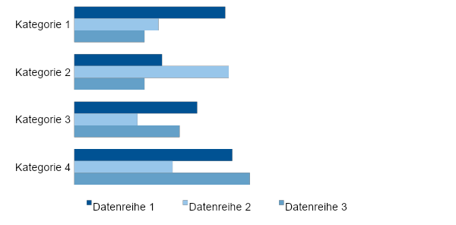
Diagramme – Beispiel 1
Nach Möglichkeit linksbündig bleiben
Unnötige Striche und Balken vermeiden
Dr. rer. nat. Erika Mustermann (TUM) | kann beliebig erweitert werden | Infos mit Strich trennen
‹#›

Slide 58
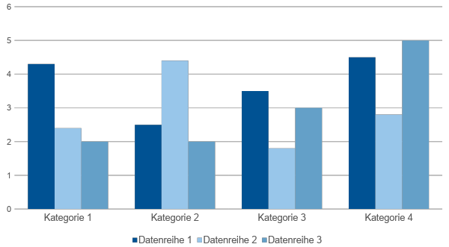
Diagramme
Dr. rer. nat. Erika Mustermann (TUM) | kann beliebig erweitert werden | Infos mit Strich trennen
‹#›

